Slide 1
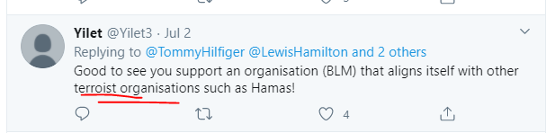
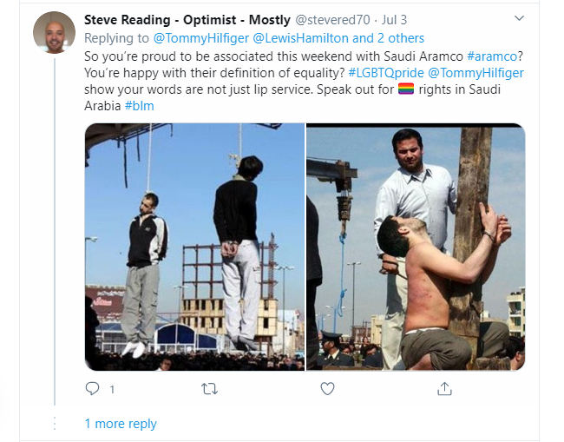
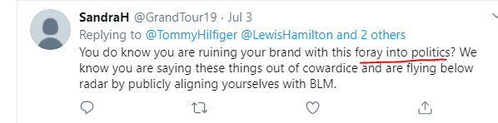
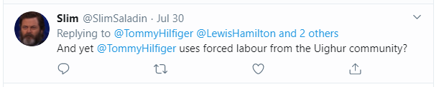
Terrorist word in the comment
Offensive posts
https://twitter.com/TommyHilfiger/status/1278674987092717568?s=20
Politics
https://twitter.com/TommyHilfiger/status/1278674987092717568?s=20
https://twitter.com/TommyHilfiger/status/1278674987092717568?s=20

Slide 2
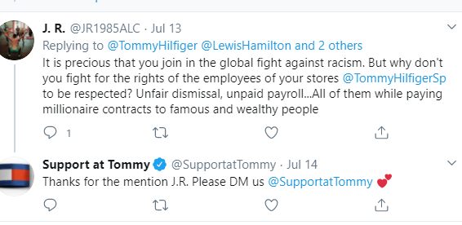
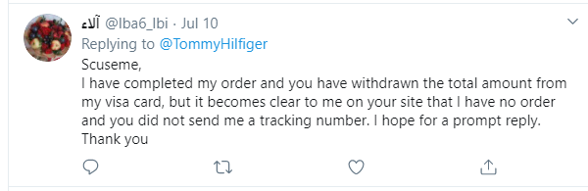
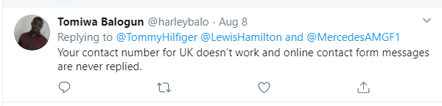
Twitter – unsatisfied customer
Response is not appropriate here
https://twitter.com/TommyHilfiger/status/1284913943337730055?s=20
Notes:
It is precious that you join in the global fight against racism. But why don’t you fight for the rights of the employees of your stores.

Slide 3
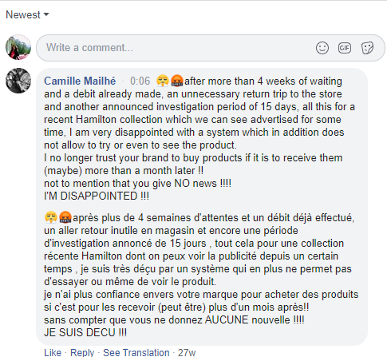
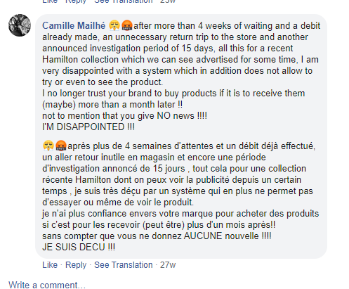
For example one user putting this comment multiple times but this has not been addressed –
https://www.facebook.com/watch/?v=2555754941357650&extid=sIUdnHFyHu6dy1Mn

Slide 4
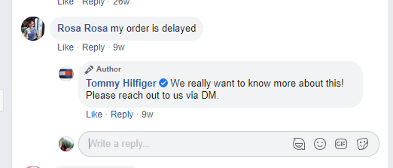
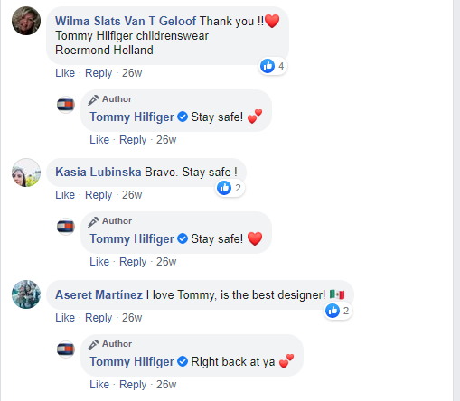
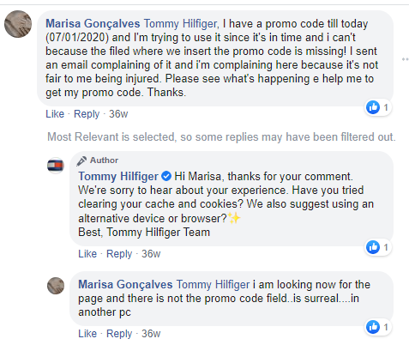
Few examples Tommy is very active

Slide 5
